Slide 1

Web Development Nanodegree
Session five
Conducted by: Hamza
Notes:
V imp links
Intro to Backend - Udacity: https://classroom.udacity.com/courses/ud171
Deploying Web Applications with Heroku - Udacity: https://classroom.udacity.com/courses/ud272
Writing READMEs - Udacity: https://classroom.udacity.com/courses/ud777
Networking for Web Developers - Udacity: https://classroom.udacity.com/courses/ud256/lessons/7090748708/concepts/70675111450923
HTTP & Web Servers - Udacity: https://classroom.udacity.com/courses/ud303/lessons/6ff26dd7-51d6-49b3-9f90-41377bff4564/concepts/ab2f6d8d-fef4-4997-9768-e6e73325b9cb
Google Maps APIs - Udacity: https://classroom.udacity.com/courses/ud864/lessons/8304370457/concepts/83061122970923
Client-Server Communication - Udacity: https://classroom.udacity.com/courses/ud897/lessons/8162118632/concepts/81893830650923
Front End Frameworks - Udacity: https://classroom.udacity.com/courses/ud894/lessons/7084452321/concepts/70929589470923

Slide 2
Agenda
CORS
Pagination
Error handling
Breakout rooms

Slide 3
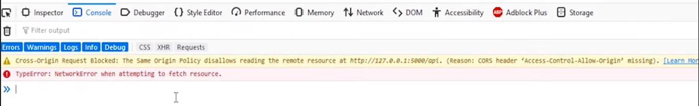
Teaser
Notes:
Have u written js and faced this error?

Slide 4

Notes:
A resource has certain policies to be shared with certain domains

Slide 5
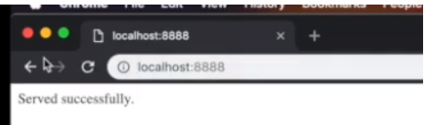
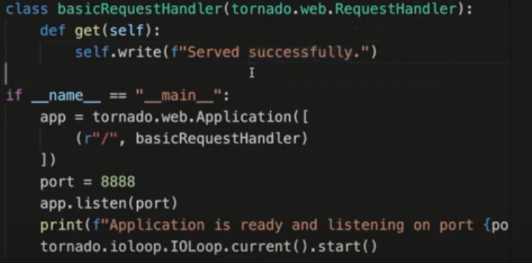
Scenario
Notes:
Simply u are on the same domain and port

Slide 6
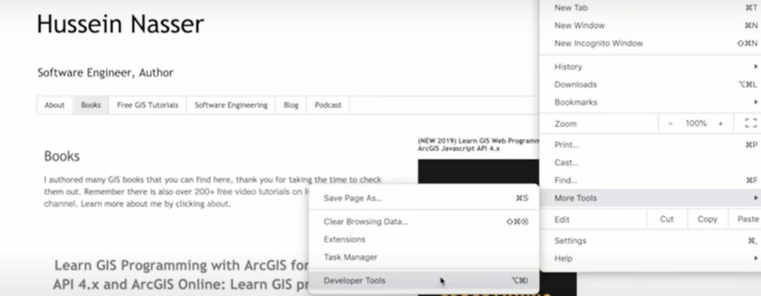
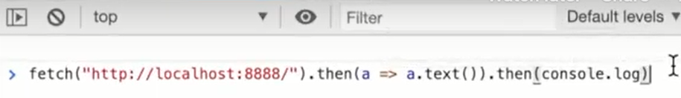
What to expect?

Slide 7
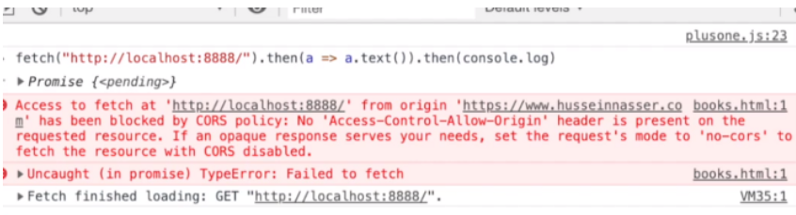
How to solve?
Notes:
If u can’t see the header, then this means only me can access this resource

Slide 8
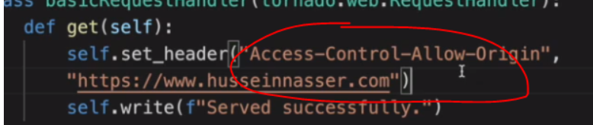
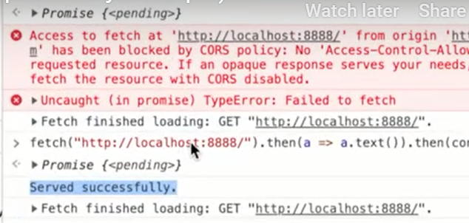
Solution
Notes:
Any one from hussien Nasser or localhost:8888 can access the resource

Slide 9
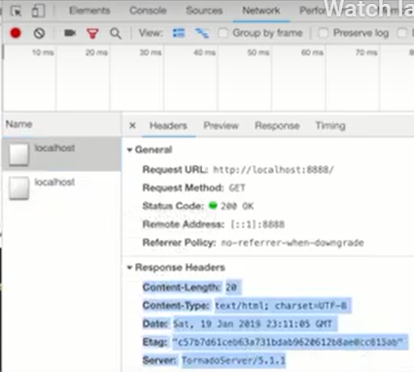
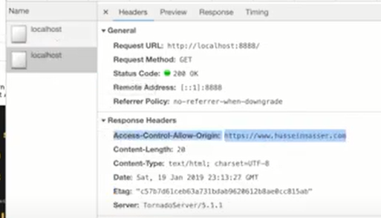
1st vs 2nd request in Network tab

Slide 10
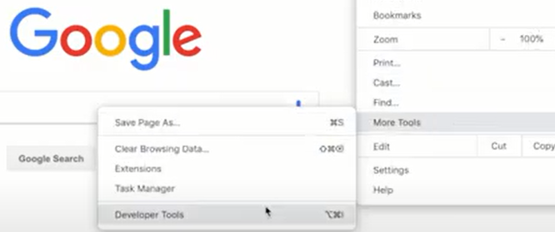
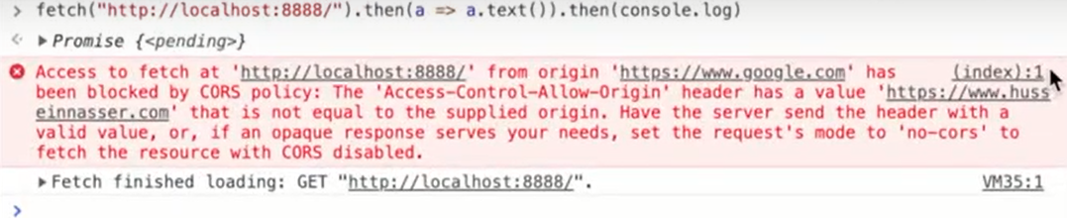
What does the error mean?
How can we allow everybody?
Notes:
There is a header but a value no equal to the supplied origins

Slide 11
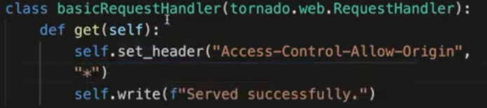
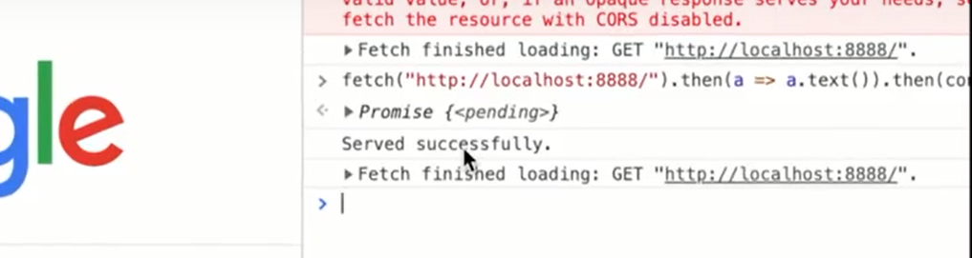
Solution

Slide 12
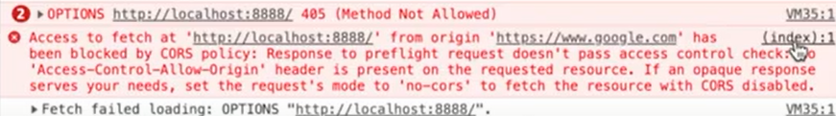
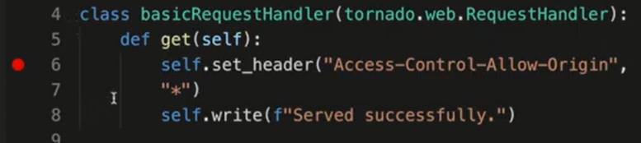
Why did it fail?
Notes:
Code did not get executed
Because the preflight failed
U r trying to send something complex.
Maybe u r trying to flood the server with stuff
I should first check whether u are allowed or not

Slide 13
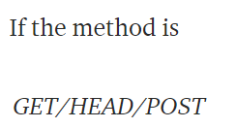
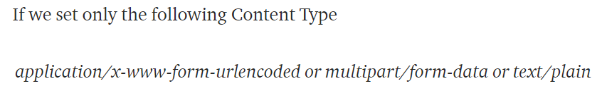
Simple request
What about authorization?
Why the previous request wasn’t simple?

Slide 14
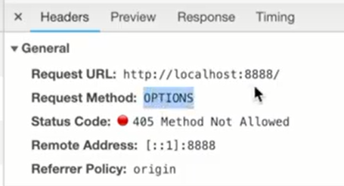
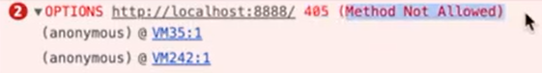
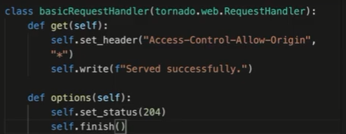
Notes:
The server had no idea what is OPTIONS as it is not defined in backend
The HTTP 204 No Content success status response code indicates that a request has succeeded, but that the client doesn't need to navigate away from its current page

Slide 15
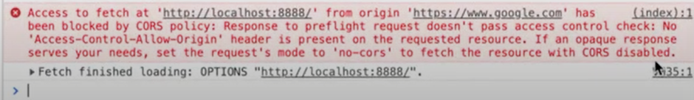
Familiar?
Notes:
Again
U need further CORS on OPTIONS

Slide 16
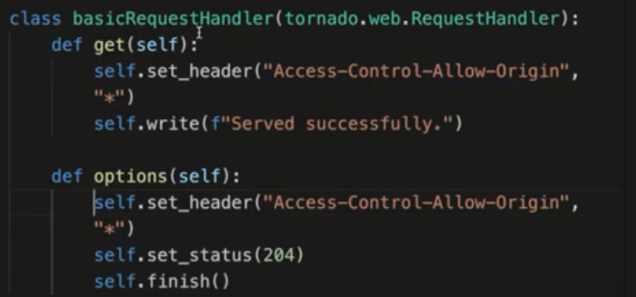

Slide 17
What again?

Slide 18
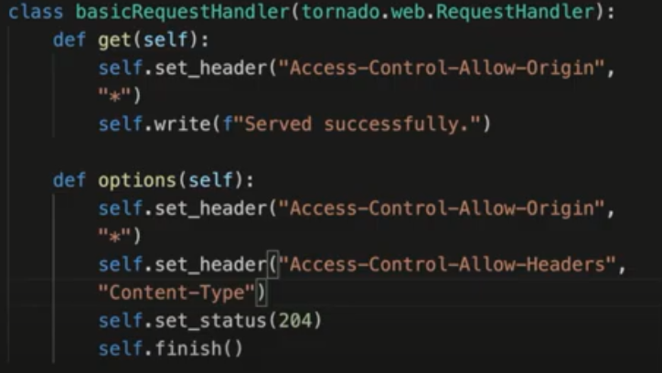
Solution
In which order will the code be executed?
Notes:
All options then the get

Slide 19

More info?
How to open medium?

Slide 20
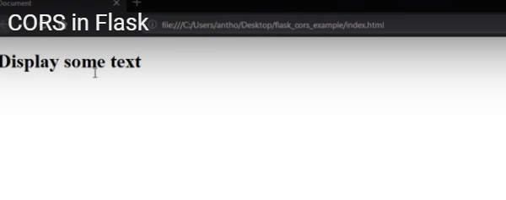
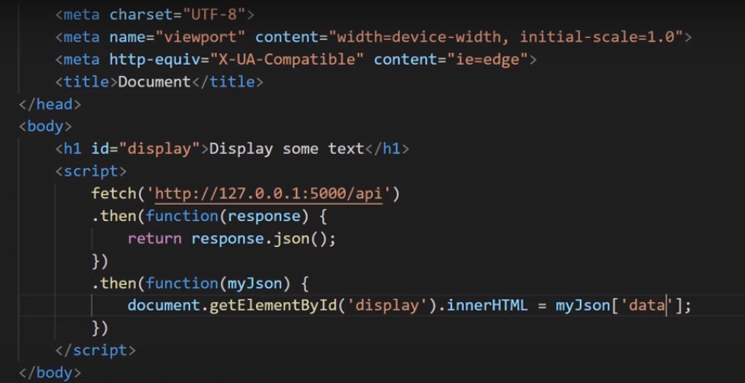
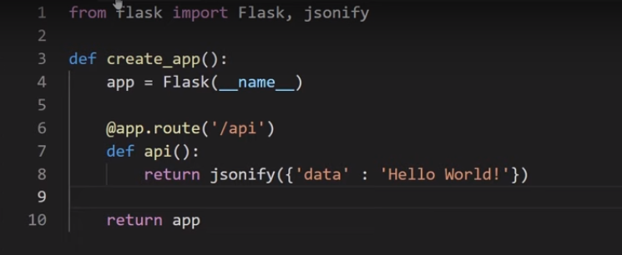
illustration
Notes:
I found this,, why ?? Why hello world wasn’t added?

Slide 21
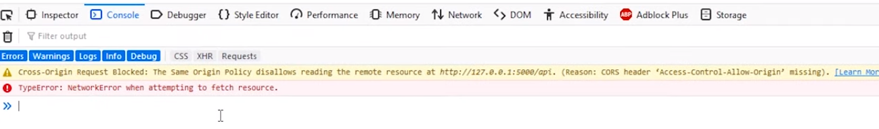
Notes:
Even if js and API is on the same computer

Slide 22
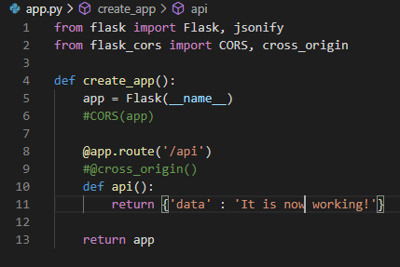
Solution

Slide 23

CORS
Notes:
Right : port
Down : different sub-domain
Up: different protocol

Slide 24
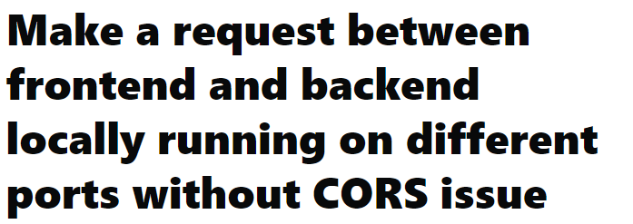
Notes:
Which one will we be facing ?
Port issues

Slide 25



Notes:
Similar to what we had in project 2
https://dev.to/nikhilponnuru/make-a-request-between-frontend-and-backend-locally-running-on-different-ports-without-cors-issue-4oje

Slide 26
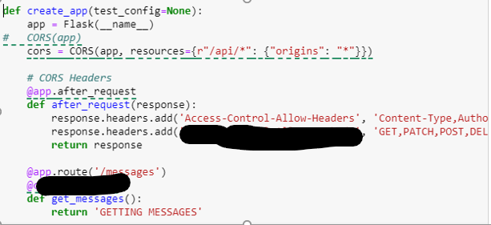
Notes:
Access control allow methods
OPTIONS requests are automatically implemented and HEAD is also automatically implemented if GET is present.

Slide 27
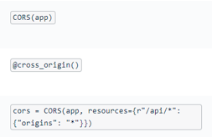
Which one is the safest?

Slide 28
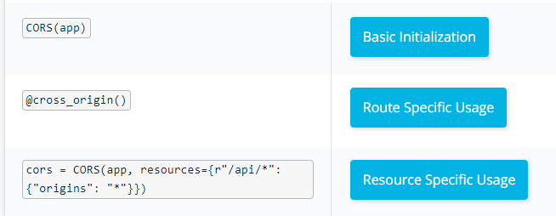

Slide 29

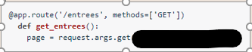
Multiple query parameters
Add pagination
Notes:
Eshra7 pagination flask in detail
change the order of the importing sqlalchemy and connecting to postgres
Send a post request to tasks/1 and expect them to say u can’t
Use put instead of patch for partial update
Request Arguments
In flask, when a request is received with query params the route in the @app.route decorator remains the same and the request object arguments contains the parameter.
request.args is a Python dictionary so we use the get method to access the value

Slide 30
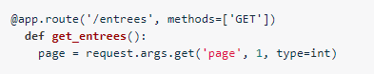
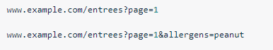
Solution
Notes:
change the order of the importing sqlalchemy and connecting to postgres
Send a post request to tasks/1 and expect them to say u can’t
Use put instead of patch for partial update
Request Arguments
In flask, when a request is received with query params the route in the @app.route decorator remains the same and the request object arguments contains the parameter.
request.args is a Python dictionary so we use the get method to access the value

Slide 31
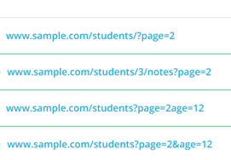
Which one is incorrect?
Notes:
Second and forth

Slide 32
Trivia project

Slide 33
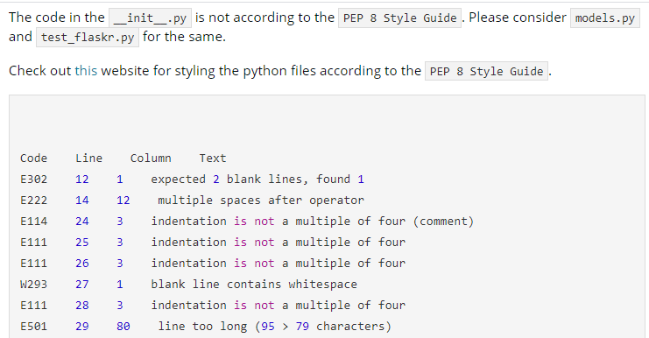

Slide 34
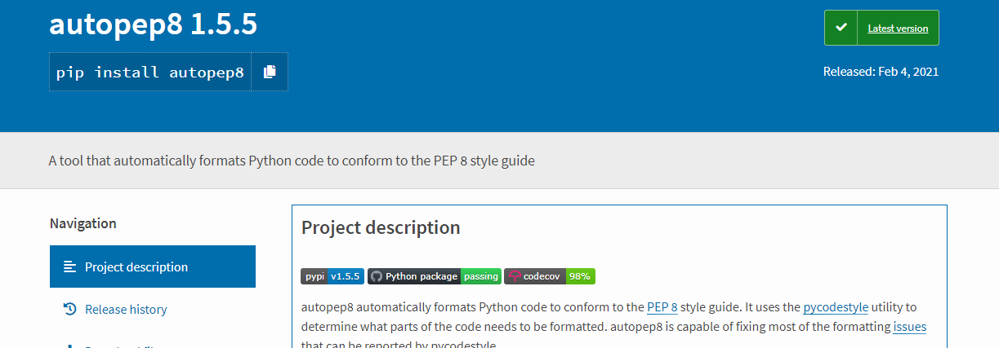

Slide 35
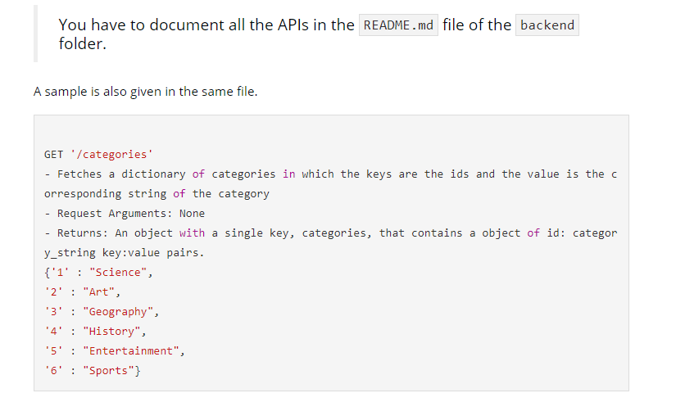

Slide 36
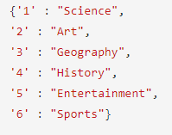
Dictionary

Slide 37
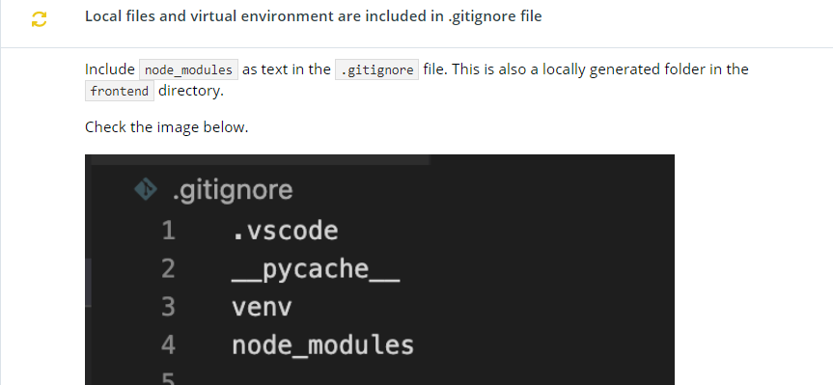

Slide 38
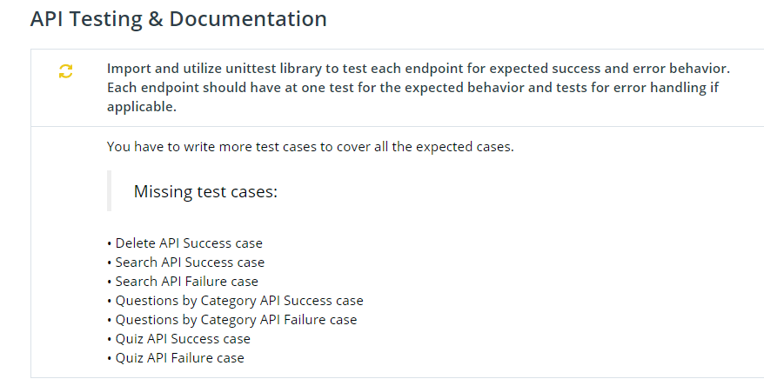
At least one for each one

Slide 39
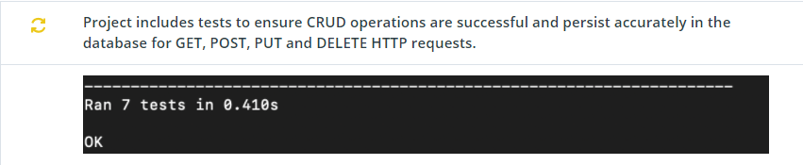
Delete?

Slide 40
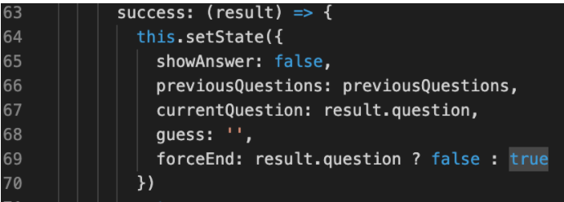


Slide 41
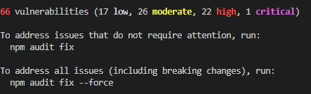
Notes:
I raun npm audit fix

Slide 42


Slide 43
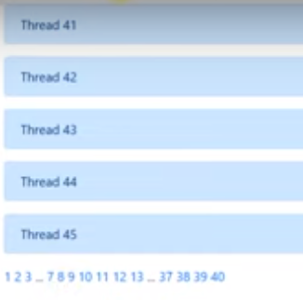
Pagination Task

Slide 44
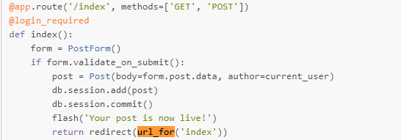
Why url_for?

Slide 45
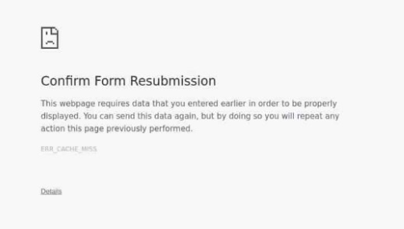
Looks familiar?

Slide 46
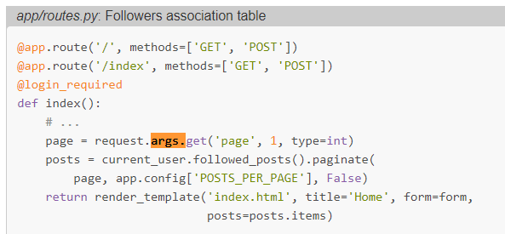


Notes:
White from Miguel
Black from pretty printed
Why are they different?
1- hard coded per page in pretty printed
2- args.get in Miguel, because he wants to access it from the home page, not necessarily if the user entered thread/page_num
3- error True or False,
4- multiple routes for the same method. Yes it is possible. But u can’t have multiple methods
If True a 404 is produced

Slide 47


Has next has prev url_for
Notes:
https://blog.miguelgrinberg.com/post/the-flask-mega-tutorial-part-ix-pagination
One interesting aspect of the url_for() function that I haven't discussed before is that you can add any keyword arguments to it, and if the names of those arguments are not referenced in the URL directly, then Flask will include them in the URL as query arguments.

Slide 48

Output

Slide 49

Dynamic Routes
Better alternative?
Notes:
a profile page for every user that creates an account within our app or dynamically generate article URLs based on the publication date.
https://hackersandslackers.com/flask-routes
Every web framework begins with the concept of serving content at a given URL. Routes refer to URL patterns of an app (such as myapp.com/home or myapp.com/about). Views refer to the content to be served at these URLs, whether that be a webpage, an API response, etc.
Years of web development taught us that URLs tend to change all the time, typically for business or SEO purposes, whereas the names of pages generally always stay the same.
Routes can accept the following variable types:
string: Accepts any text without a slash (the default).
int: Accepts integers.
float: Accepts numerical values containing decimal points.
path: Similar to a string, but accepts slashes.

Slide 50


Solution
Notes:
url_for() comes in: this built-in function takes the name of a view function as input, and will output the URL route of the provided view. This means that changing route URLs won't result in broken links between pages! Below is the correct way to achieve what we did above:

Slide 51
Another use

Slide 52

Sometimes we forget
Notes:
What does dir() do ?

Slide 53


Slide 54

errorhandler
404 outside jsonify?

Slide 55


Notes:
Default values
200
And HTML
U override this with 201 and app json

Slide 56


Notes:
One imp thing about error handler is that it enables us to be consistent, response is json and error is json
When we don’t need the word error to be passed within parenthesis ?
What would happen if we didn’t return the status code at the very end ?

Slide 57



Error handling
Notes:
passing the status code or Python error as an argument to the decorator

Slide 58



Is it worth it?

Slide 59





Slide 60

Flash
When to use?
Where to implement?
Debug??
Breakout

Slide 61


Flash
Notes:
https://pythonprogramming.net/flash-flask-tutorial/
https://pythonise.com/series/learning-flask/flask-message-flashing

Slide 62
Thank you!

